Slide 1
Cryptography in “Pre-Post-Quantum” Time
Lily Chen
Cryptographic Technology Group
Computer Security Division, Information Technology Lab
National Institute of Standards and Technology (NIST)

Slide 2
Outline
Status of NIST PQC Standardization Project and Next Steps
Update on NIST Cryptographic Standards and Classical Security
Preparation and migration
  Hash-based signatures
  Hybrid mode and dual signatures
  Symmetric key based solution
Important awareness and decisions
Summary

Slide 3
Where are we?
NIST received 82 total submissions received from 25 Countries, 6 Continents
  The submitters in USA are from 16 States
69 “complete and proper” submissions accepted as the first round candidates (5 since withdrawn)
The First NIST PQC Standardization Conference was held in April 2018
We are in the analysis and evaluation stage
Analysis and evaluation
More analysis …
Submission due
2nd round candidates
3rd round candidates
Draft standards
1st round candidates
1st conference
2nd Conference
………
Nov. 30, 2017
Dec. 2017
April, 2018
Aug. 2019
2022-2023

Slide 4

Scope of NIST PQC Standardization
Crypto standards
Post-Quantum Cryptography
Public key based
Symmetric key based
Guidelines
AES (FIPS 197 ) TDEA (800-67)
Hash usage/security (800-107)
Signature (FIPS 186)
Modes of operations (800 38A-38G)
Transition (800-131A)
Key establishment (800-56A/B/C)
Key generation (800-133)
SHA-1/2 (FIPS 180) and SHA-3 (FIPS 202)
Key management (800-57)
Tools
Randomized hash (800-106)
RNG (800-90A/B/C)
HMAC (FIPS 198)
KDF (800-108, 800-135)
SHA3 derived functions (parallel hashing, KMAC, etc. (800-185)

Slide 5
First Round Candidates
Most submitted schemes (or previous versions) have been published at the conferences or released through IACR eprint – In general, no big surprise
Most submissions include proofs/discussions on the CCA/CPA security for Encryption/KEM and EUF-CMA for signatures
Most submissions addressed the rationale for the selected parameters and mathematics structures as well as pros and cons of the schemes
 | Signatures | KEM/Encryption | Overall
Lattice-based | 5 | 21 | 26
Code-based | 2 | 17 | 19
Multivariate | 7 | 2 | 9
Stateless Hash-based/symmetric key | 3 |  | 3
Other | 2 | 5 | 7
Total | 19 | 45 | 64

Slide 6
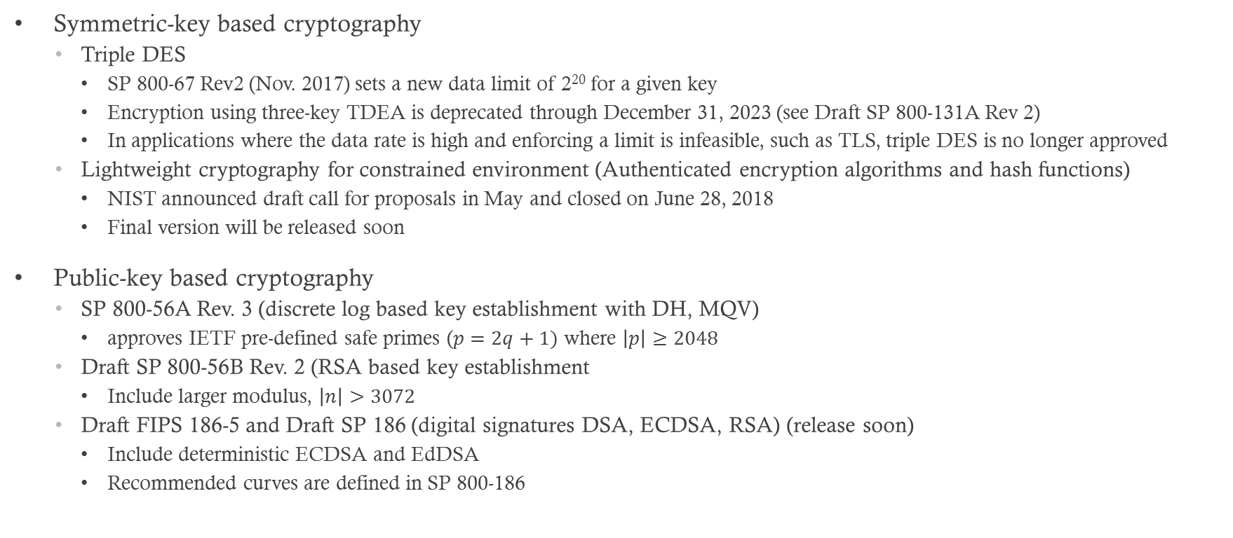
NIST Crypto Standards Updates and Initiatives
Symmetric-key based cryptography
  Triple DES
    SP 800-67 Rev2 (Nov. 2017) sets a new data limit of 2²⁰ for a given key
    Encryption using three-key TDEA is deprecated through December 31, 2023 (see Draft SP 800-131A Rev 2)
    In applications where the data rate is high and enforcing a limit is infeasible, such as TLS, triple DES is no longer approved
  Lightweight cryptography for constrained environment (Authenticated encryption algorithms and hash functions)
    NIST announced draft call for proposals in May and closed on June 28, 2018
    Final version will be released soon
Public-key based cryptography
  SP 800-56A Rev. 3 (discrete log based key establishment with DH, MQV)
    approves IETF pre-defined safe primes ($p=2q+1)$ where $\left|p\right|≥2048$
  Draft SP 800-56B Rev. 2 (RSA based key establishment
    Include larger modulus, $\left|n\right|>3072$
  Draft FIPS 186-5 and Draft SP 186 (digital signatures DSA, ECDSA, RSA) (release soon)
    Include deterministic ECDSA and EdDSA
    Recommended curves are defined in SP 800-186

Slide 7
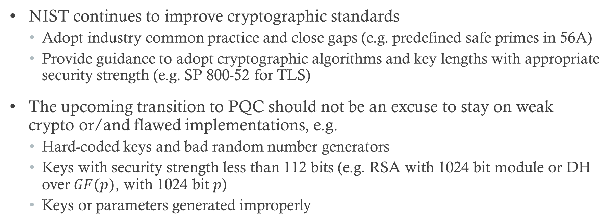
Classical Security in Pre-Quantum Time
NIST continues to improve cryptographic standards
  Adopt industry common practice and close gaps (e.g. predefined safe primes in 56A)
  Provide guidance to adopt cryptographic algorithms and key lengths with appropriate security strength (e.g. SP 800-52 for TLS)
The upcoming transition to PQC should not be an excuse to stay on weak crypto or/and flawed implementations, e.g.
  Hard-coded keys and bad random number generators
  Keys with security strength less than 112 bits (e.g. RSA with 1024 bit module or DH over $GF(p)$, with 1024 bit $p$)
  Keys or parameters generated improperly

Slide 8
Stateful Hash-Based Signatures
Stateful hash-based signature is out of the scope of NIST call for proposals but it is in the scope for PQC standardization
Two versions of stateful hash-based signatures have been proposed in IETF
  XMSS – RFC 8391 “XMSS: eXtended Merkle Signature Scheme”
  LMS – “Hash-Based Signatures” (draft-mcgrew-hash-sigs-12)
Input/feedback was solicited on whether NIST shall standardize any or both hash-based signatures
  About 20 responses were received and, in general, support NIST to standardize hash-based signatures
NIST plans to initiate the project to develop a special publication on hash-based signatures
Further question will be how much to limit hash-based signature, e.g. for code signing only or also allowing for root/intermediate certificates

Slide 9
Hybrid Mode and Dual Signatures
Hybrid mode and dual signatures have been considered as a migration path from classical public key cryptography to quantum resistant public key cryptography
  Hybrid mode key establishment – use one classical PK scheme, e.g. “DH”, and one quantum resistant scheme, each establish a “shared secret”, combine them to derive keys
  Dual signatures – sign a message twice by two schemes, one classical signature scheme, e.g. “ECDSA” and one quantum resistant scheme. Dual signatures are valid if both signatures are valid
Hybrid mode and dual signatures can help to obtain valuable experience for deploying quantum resistant schemes
The implementation burden and performance hit need to be considered
In general, it is a decision for applications
  Whether it is a long term or short term solution (one transition or two transitions)
  How to choose the quantum resistant piece to make sure it is indeed secure
For hybrid mode and dual signatures, NIST FIPS 140 validation will validate “approved” components, that is,
  For hybrid mode, validation is on classical PK scheme specified in SP 800-56A or SP 800-56B
  For Dual signatures, validation is on the signature scheme specified in FIPS 186

Slide 10
Symmetric Key Cryptography Solution
To deal with quantum attacks on public-key cryptography currently in use, some approaches tentatively suggest to fall back to pure symmetric key solutions through
  Pre-distributed key or
  Quantum key distribution (QKD)
The pure symmetric key crypto may work if a secure key distribution/update infrastructure is in place, e.g.
  Cellular system with USIM card and service provider managed authentication center
  Kerberos to authenticate and transport keys for targeted services
Quantum key distribution demands all the terminals to be equipped with quantum interface
  Otherwise, key distribution with protected channel is demanded
Many-to-many communication networks have relied on public key cryptography to establish secure communications in the past 20 years, e.g. IKE, TLS, etc.
  Falling back to symmetric-key based solution proposes a challenge in key distribution

Slide 11
Important Awareness and Decisions
Current NIST Standards cover the essential crypto primitives, in particular, for PK system
  Key establishments (SP 800-56A/B); and
  Signatures (FIPS 186)
We are aware that many applications need deploying other crypto tools to provide special features such as
  Ring signature/group signature
  Identity/Attribute based encryption (IBE or ABE)
  Zero-knowledge proofs
Foreseeing the transition to PQC, to provide the same feature in the new applications, it is very important to consider quantum resistant primitives

Slide 12
Summary
Mind classical attacks
  Attackers are not waiting for quantum computers
Identify and eliminate flawed implementations
  These are more dangerous than quantum computers
For NIST PQC standardization
  Tell us what you can or cannot handle in your applications with regard to key size, ciphertext size, signature size, key generation, decryption failure, processing complexity, etc. and the preference in tradeoffs
Prepare for the transition
  Facilitate crypto agility in new protocols and applications
  Consider quantum resistant primitives for new features

Slide 13
Contact Information
See http://csrc.nist.gov for crypto standards, updates, call for public comments, workshops and conference
Join the discussion group pqc-forum@nist.gov
The 1st round candidates are posted at http://www.nist.gov/pqcrypto with presentations at the 1st NIST PQC Standardization Conference
For comments, questions, or suggestions, send e-mail to pqc-comments@nist.gov

